Slide 1

Ramesh’s Story

Slide 2
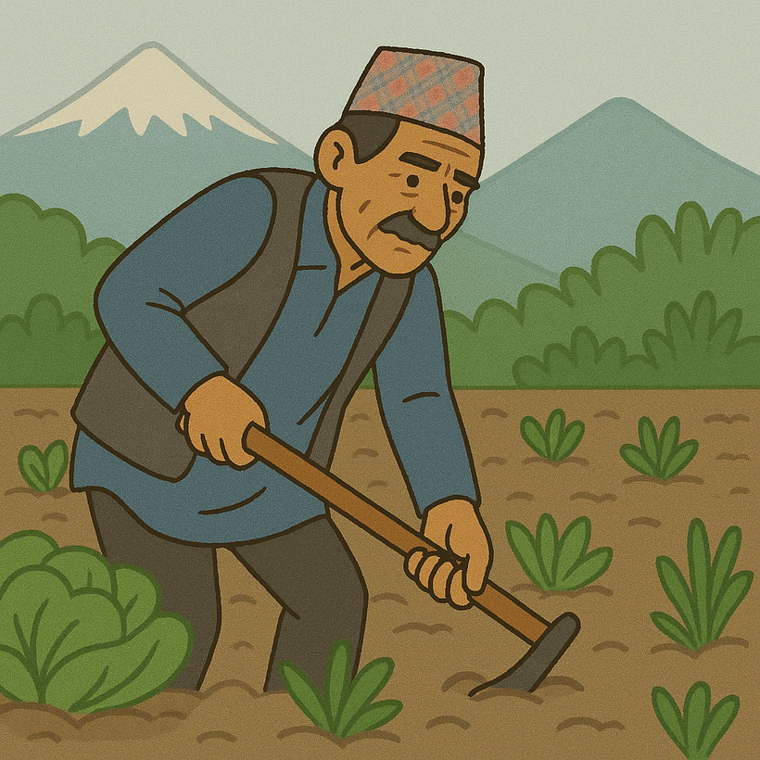
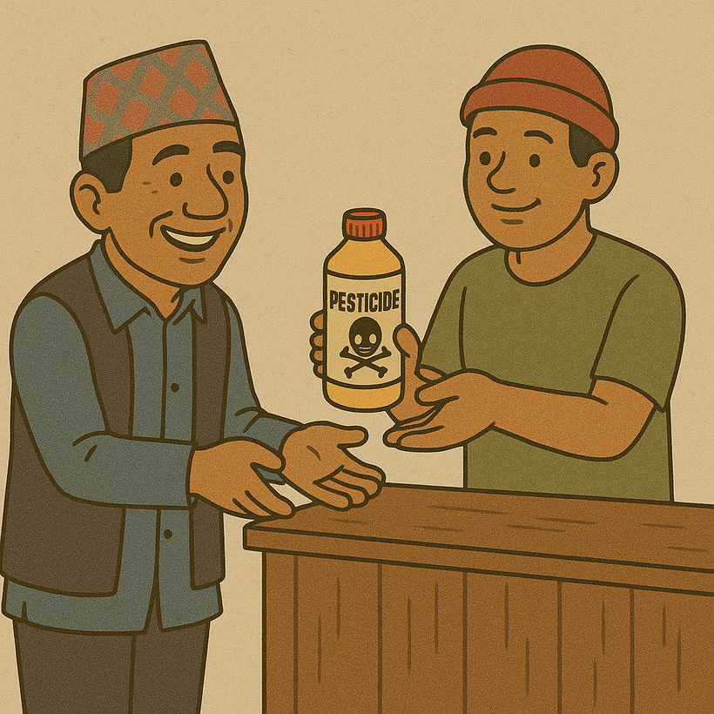

Slide 3
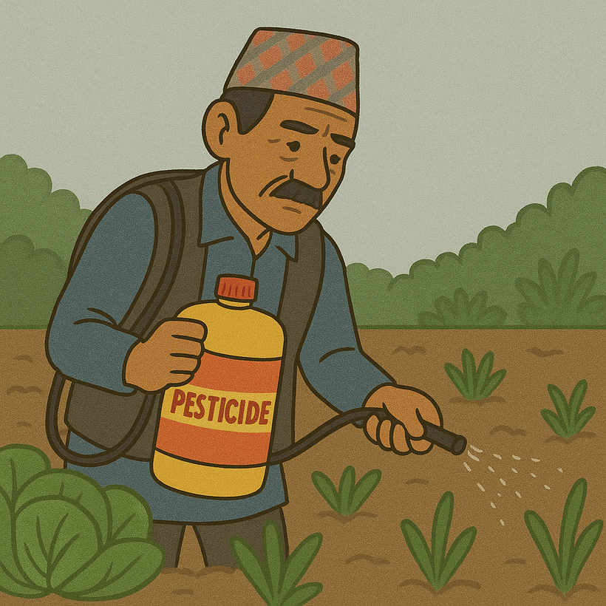
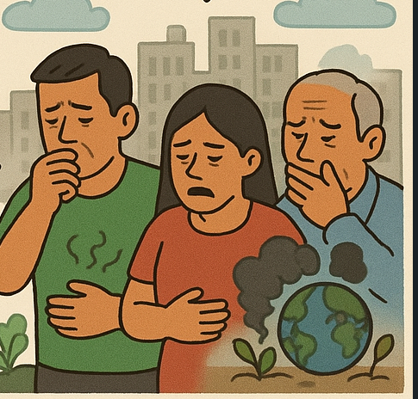

Slide 4


Team Members
Puspa Regmi
Roshan Bhatta
Rajan Raj Acharya
Nikhil Khatri

Slide 5

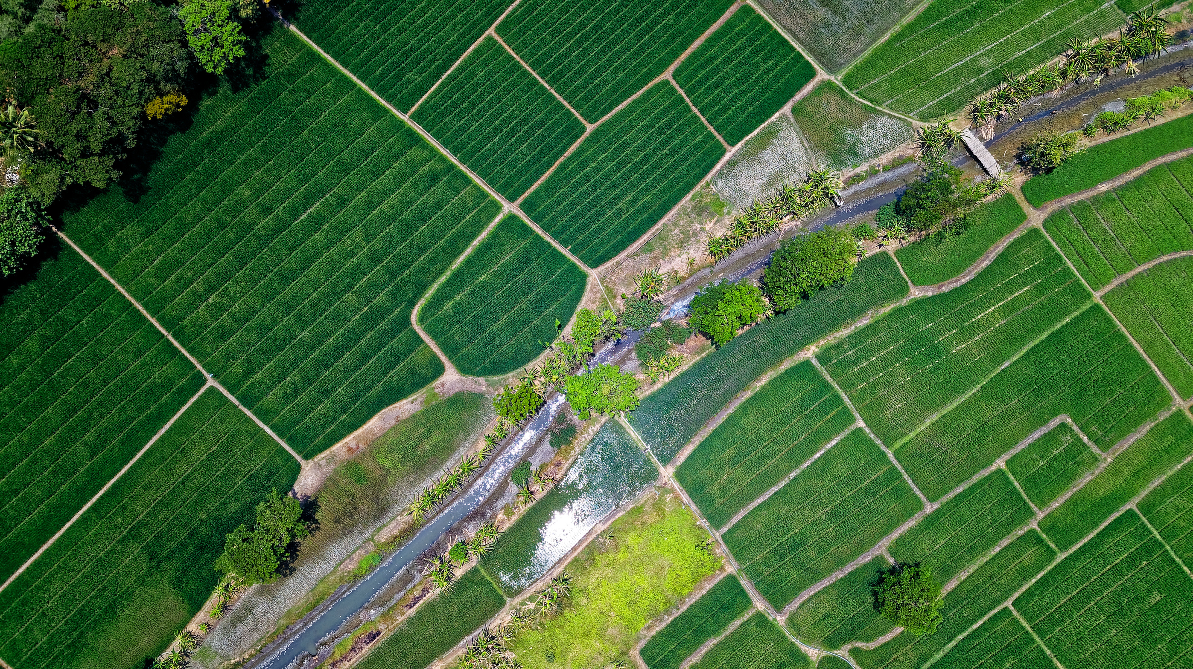
फार्म एआई
तपाईंको कृषि साथी

Slide 6
Problem Satement
Unsafe farming and post-harvest practices by unaware Nepali farmers are contributing to foodborne illnesses — Farm AI empowers them with simple, practical guidance to ensure food safety from farm to market.

Slide 7
Agriculture is the backbone of Nepal, with farmers playing a crucial role infeeding the nation.
Many Nepali farmers lack proper literacy and awareness about the correct amount, timing, and application of fertilizers.
Knowledge Gap and unhealthy and chemically imbalanced food production.
Lack of farmer-friendly platforms in Nepal that provide easy-to-understand guidance on fertilizer use.
A platform is needed that is accessible, supports Nepali language, and can be used effectively by farmers.

Slide 8
Proposed Solution
Farm AI
A voice-enabled tool to guide Nepali farmers on using fertilizers for healthier crops.
Speech-to-Text & Text-to-Speech: Makes the platform accessible to farmers with low literacy through voice commands and audio feedback.
Provides crop-specific, region-based advice on the right amount and timing of fertilizer to produce healthier food.

Slide 9
AIM
To develop accessible agro-platform that guides Nepali farmers to produce healthier crops by the proper use of fertilizers and crops knowledge.
OBJECTIVES
To educate farmers on the correct amount, type, and timing of fertilizer application.
To implement speech-to-text and text-to-speech features for accessibility among low-literacy farmers.
To reduce the overuse and misuse of fertilizers that lead to unhealthy food and environmental harm.

Slide 10
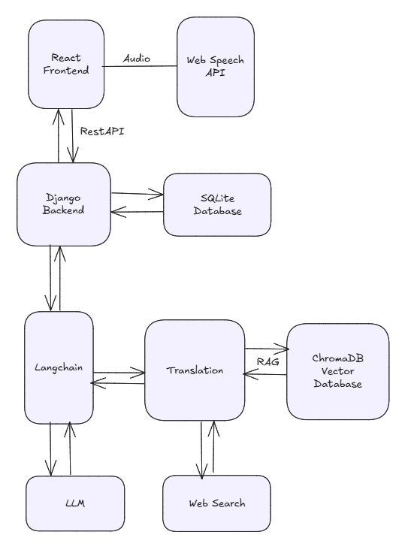
Methodology

Slide 11
Current Features
Speech to text for accessibility.
Supports Nepali Language.
UI theme aligned to Agriculture.
Answers by FarmAI that gives crop specific feedbacks.
Food Safety First
Post-Harvest Safety Guidance
Farmer-Friendly Conversations
Data Sources: Nepal Seed and Fertilizer Project, Department of Agriculture, NIOS, Research Gate, Food And Agriculture Organization

Slide 12
Limitations
Due to less data the FarmAI won’t give specific results.
Due to scarcity of data using of Indian agriculture data.
Only development of application in Web.

Slide 13
Future Plans
Mobile Application Development.
Data collection through local authorities and make the response better.
Feed Section Implementation.
Shop recommendation feature with gps enabled.
Collect data and make the data open source to encourage research contribution on agriculture.
Help bodies to make data driven decision through the help of collected data.
Weather Prediction and Feedback.

Slide 14
What makes FarmAI different?
From our research till now none of the agro-specific chat assistant have been officially deployed in Nepal.
We have found couple of competitiors who have been working on this project.
FarmAI unique Features:
Feed Section for awareness.
Nearer Shop recommendation.

Slide 15
RISK ASSESSMENT
Usability Risk: Farmers with little to no digital experience may find it difficult to use even a simplified interface.
Financial Risk: Lack of funding to develop, scale, and maintain the platform long-term.
Technical Risk: Inaccurate or generic fertilizer recommendations .
Market Risk: Farmers may not adopt the platform due to lack of trust, awareness, or perceived value.

Slide 16
Special Thanks To
Our Mentor
Mr. Bishow Lamsal

Slide 17
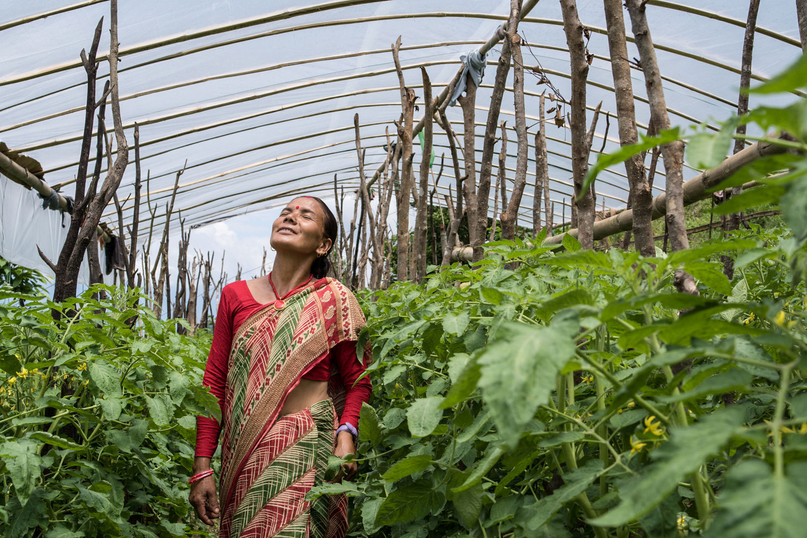
THANK YOU

